Slide 1
Robotics and Artificial Intelligence Nigeria (RAIN) By Dr Olusola Ayoola

Slide 2
Partnership
for Technological Advancement
Dr. Olusola Sayeed Ayoola, B.Sc (Ib.) M.Sc (Manc.), Ph.D (Manc.), MIET ,MNSE,MNCS
CEO | Robotics and Artificial Intelligence Nigeria (RAIN)

Slide 3
RAIN
Founded in 2019
Robotics and Artificial Intelligence Nigeria (RAIN) has grown to be Nigeria’s leading facility for research, training and certification in Robotics and Artificial Intelligence.
Located in a serene environment in Iyaganku G.R.A, Ibadan, Oyo State.
RAIN designs a structured training curriculum, delivers training, conducts research and engages in product designs and development for organizations.

Slide 4
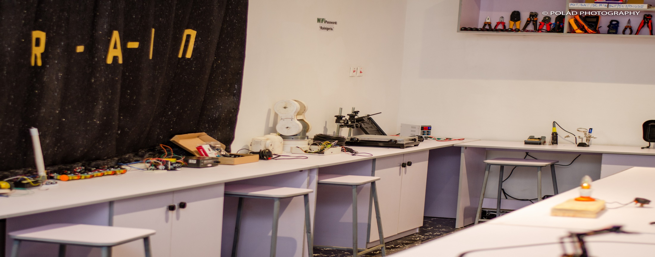
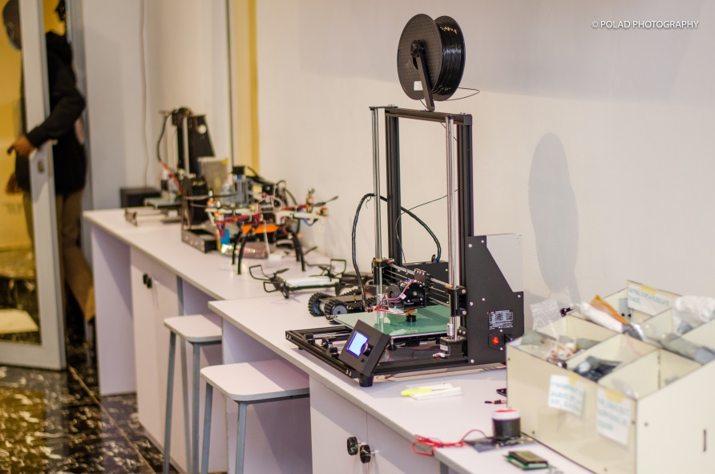
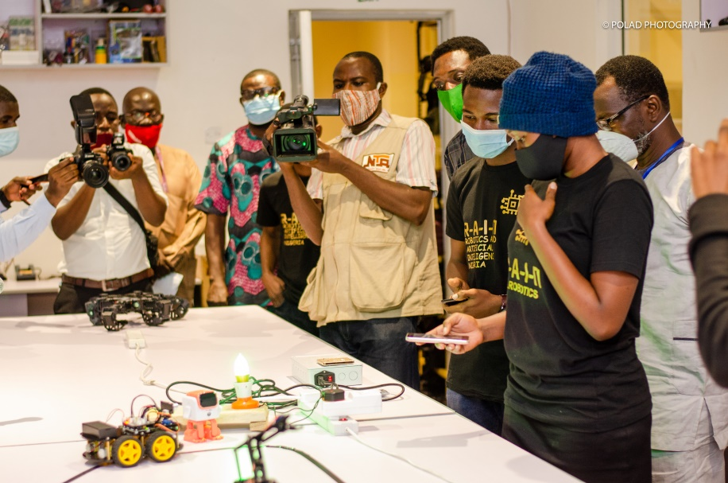
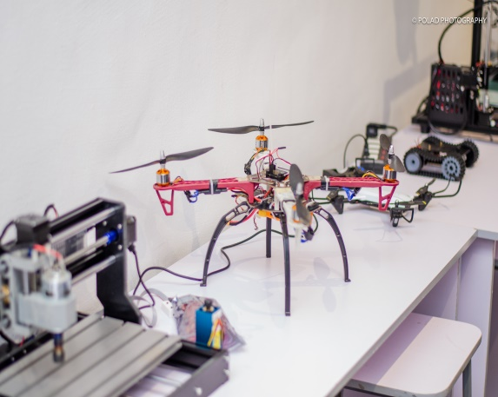

Slide 5
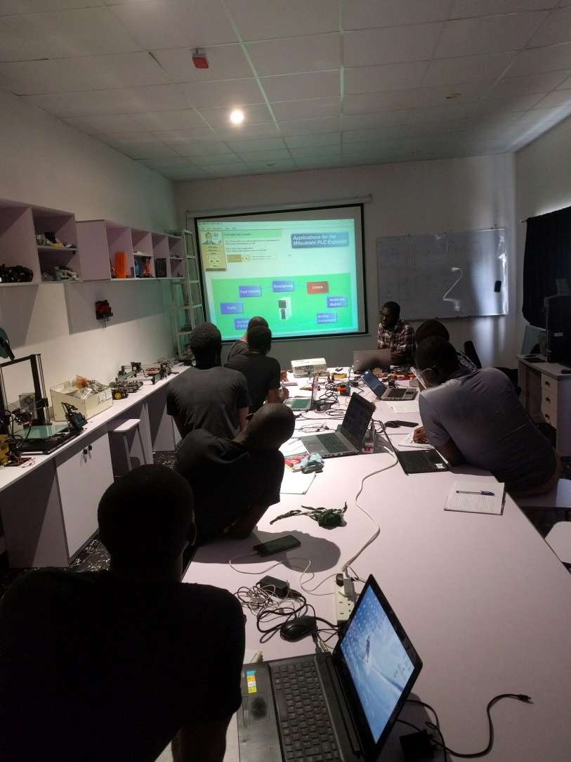
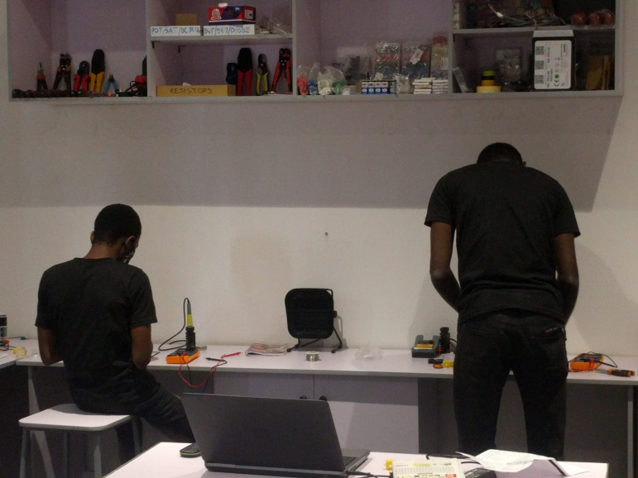
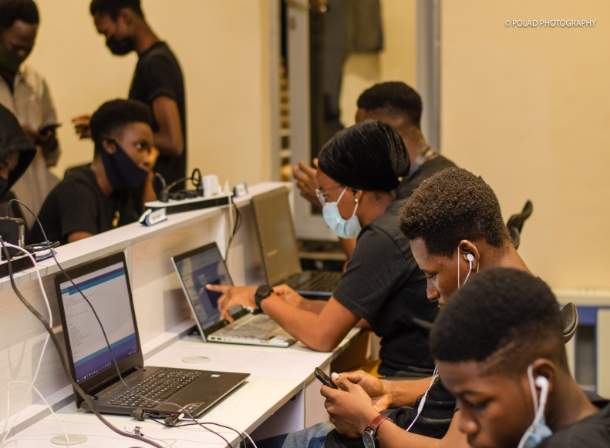
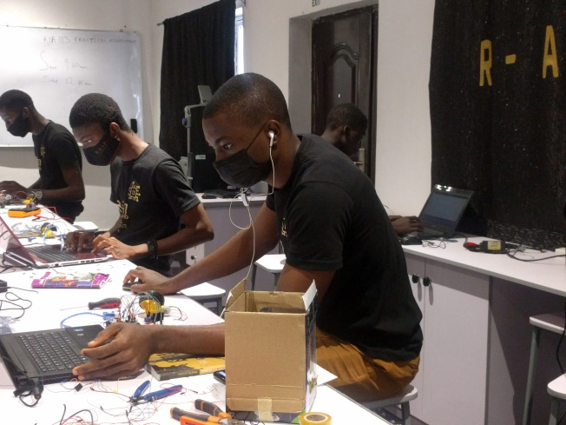
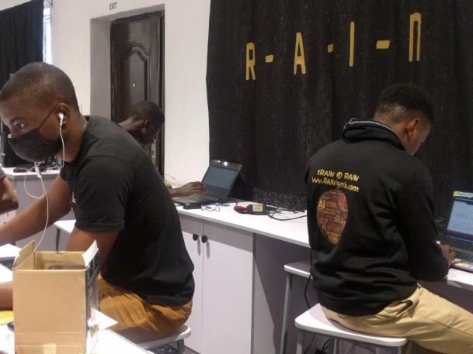
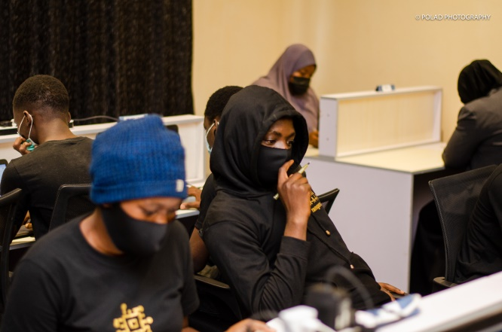
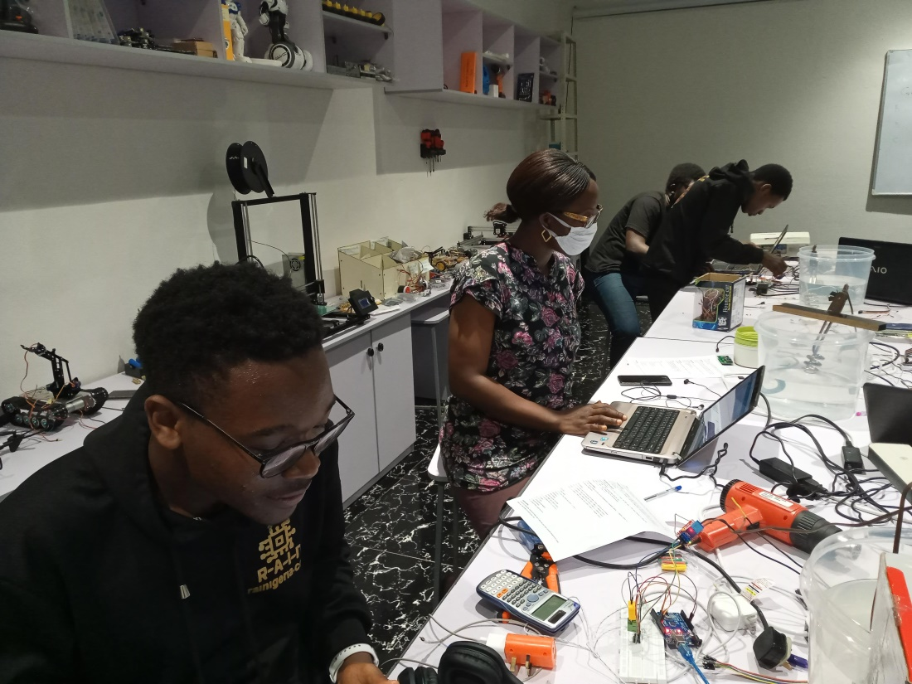
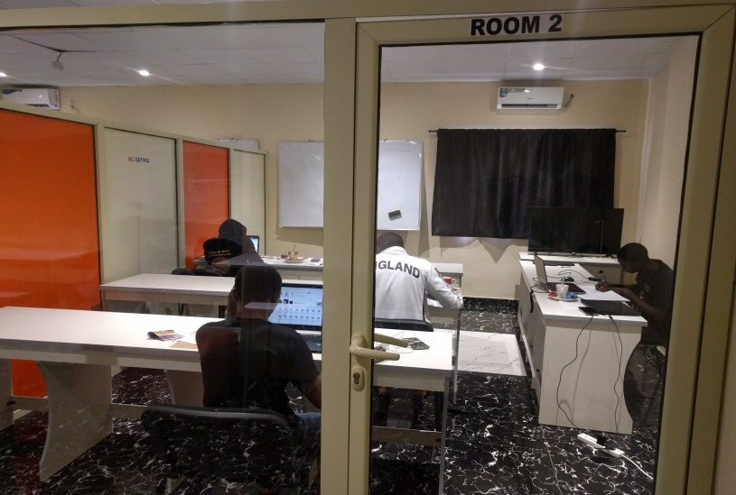
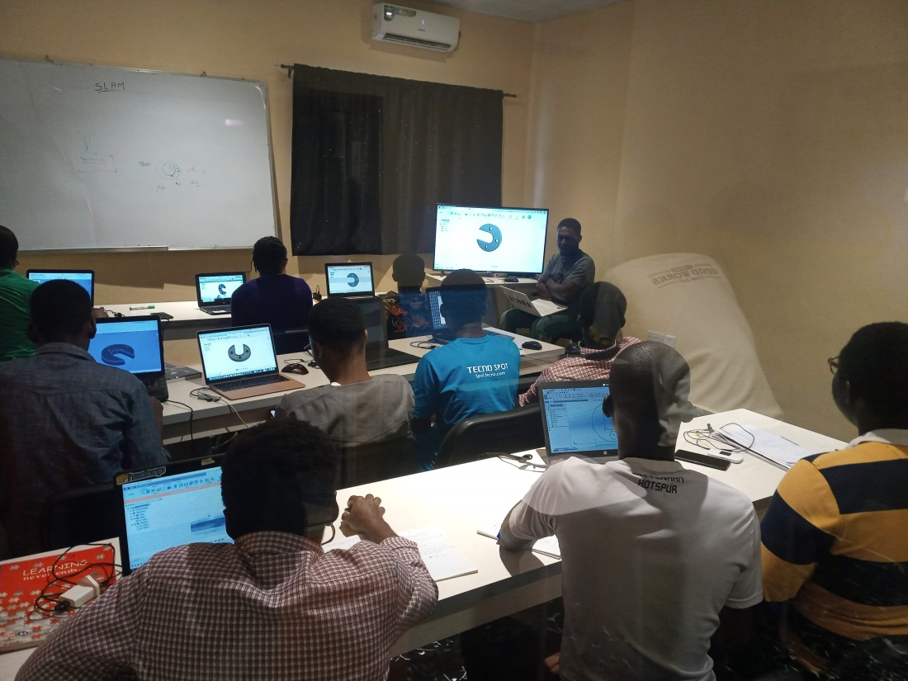

Slide 6
RAIN: The Facility is
Home to a fully equipped robotics laboratory, sound academics and researchers.
Nigeria’s concentration hub of highly skilled software and hardware developers that see no impossibilities.
Leading the discussion with stakeholders across sectors on Artificial Intelligence (AI) based interventions.

Slide 7
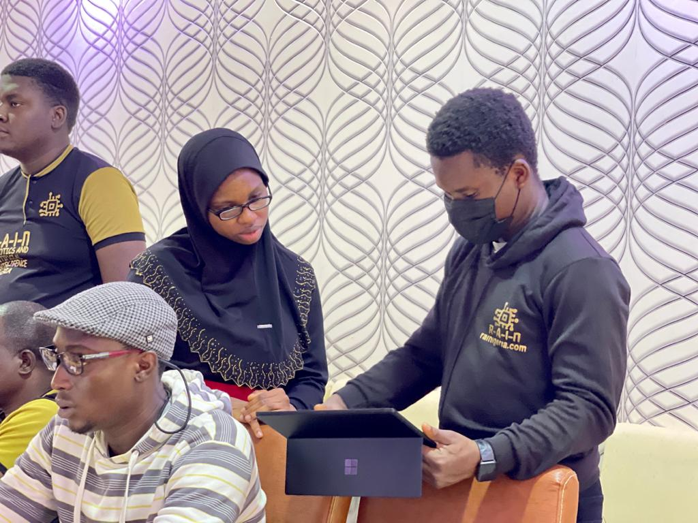

Slide 8
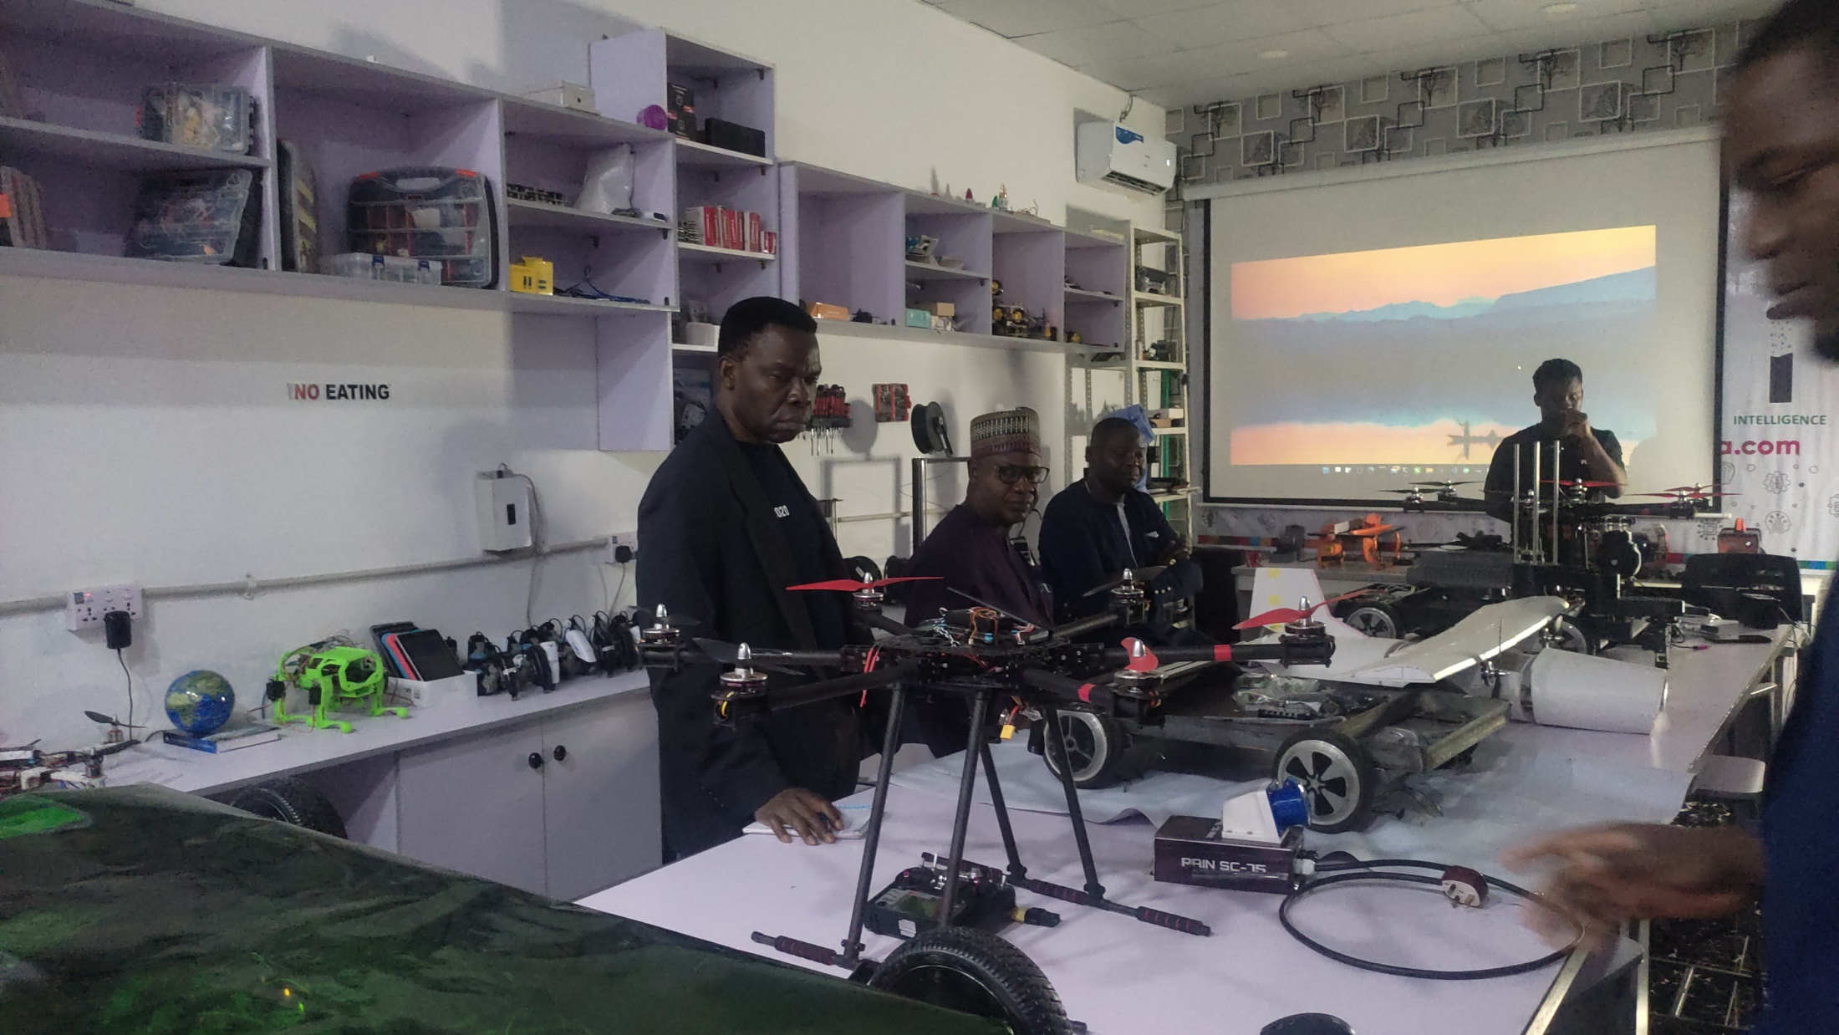

Slide 9
RAIN: The Objective
Develop a robust Curriculum in Robotics and AI.
Develop a large number of skilled workforce through practical trainings with live projects.
Enhance industry growth through 4IR-based interventions.
Promote technological advancement through ground-breaking research in AI and Robotics.
Encourage wide-spread adoption of AI and R.

Slide 10
RAIN: The Strength
Proven competitive advantage
Product Design (3D) & Parts Fabrication
Internet of Things (IOT)
Advanced Machine Learning
Deep Neural Networks
Computer Vision and Natural Language Processing NLP
Simultaneous Localization and Mapping (SLAM)
Robot Operated Systems (ROS)
Robot Process Automation (RPA)
Unmanned Aerial, Ground and Underwater Systems
Real-World Model Deployment
App Development (Web, Desktop, Android & iOS)

Slide 11
RAIN: The Milestones
Robotics and Artificial Intelligence Nigeria (RAIN) was founded in 2019 and has since grown to be Nigeria’s leading facility for research, training and certification in Robotics and Artificial Intelligence.
First International Student Arrival – October 2022
Visit of the Deputy Secretary General of the United Nations – December 2021
Resolution by the House of Representatives tasking the Federal Government of Nigeria to liase with RAIN – December 2021

Slide 12
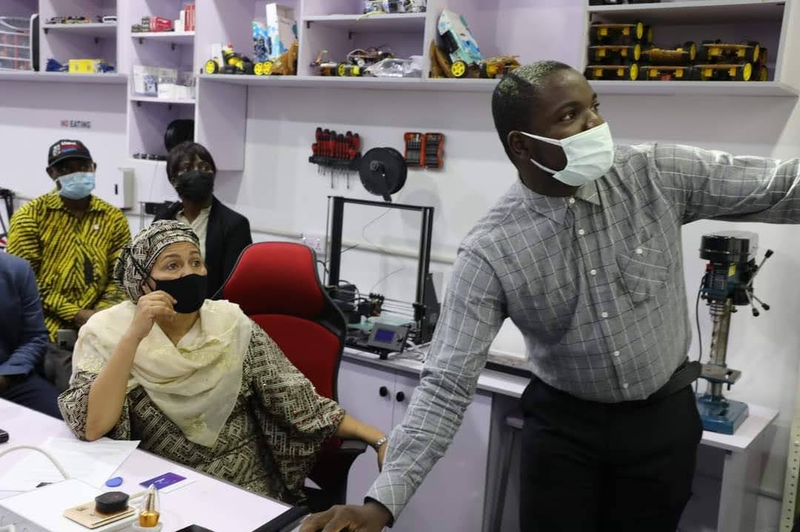
At Robotics and Artificial Intelligence Nigeria (R-A-I-N)

Slide 13
RAIN: The Milestones
The Federal Government has collaborated with RAIN severally through the following organs:
National Information Technology Development Agency (NITDA)
Security Departments
Federal Ministry of Youths and Sport Development
Other Collaborators include:
MIT LaunchX 2022
Nile University, Egypt AI4Dev 2022
The Government of Kogi State
The United Nations Development Programme (UNDP)
Adeus Ltd, United Kingdom
One Watt Solar (OWS) Ltd, UK
Trade & Investment Consultants Ltd, UK

Slide 14
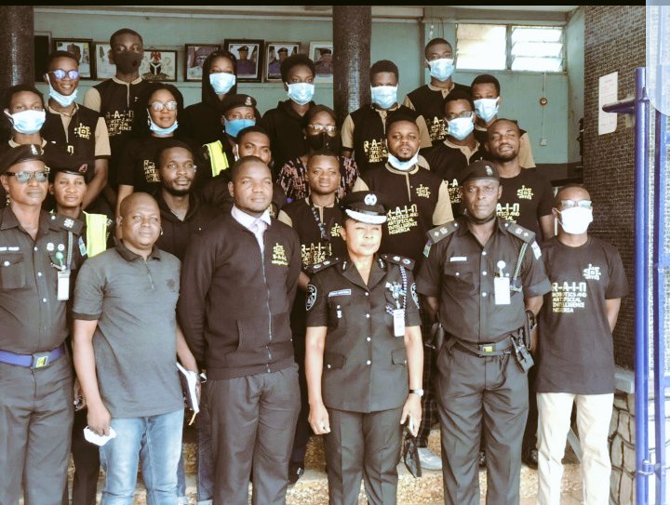
Collaboration with Nigeria Police (Oyo State)

Slide 15
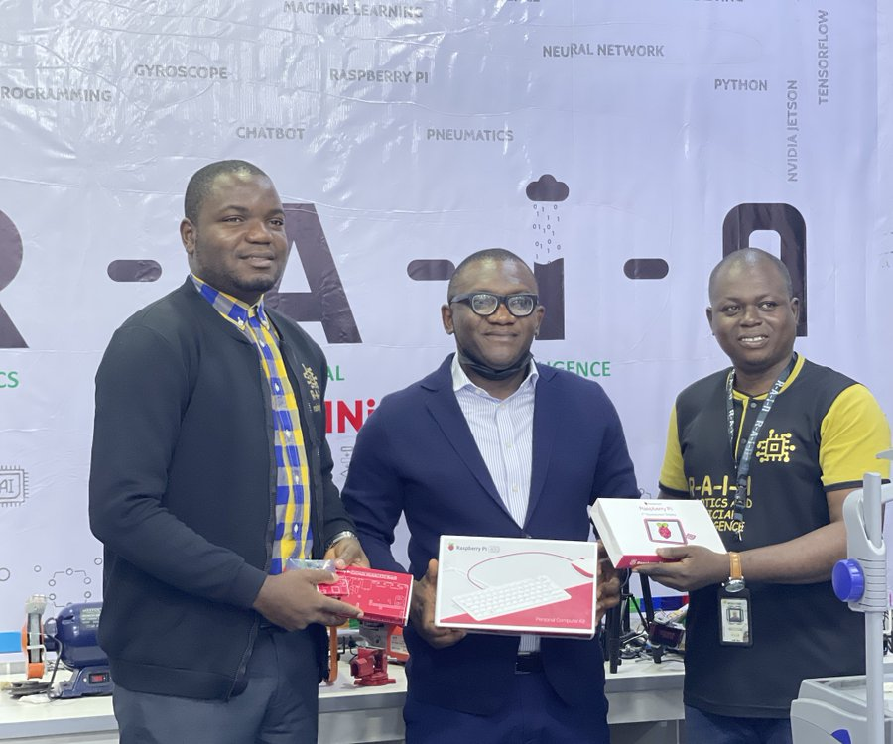
Collaboration with Raspberry Pi Africa Region

Slide 16
RAIN: Notable Projects
RAIN CEDBAS - CARBON EMISSION BASED AERIAL SURVEILLANCE SYSTEM
RAIN DBCV – AI-CV Based Drone Footage Analysis for Human Detection
RAIN IMoRP - Industrial Mobile Robotic Platform
RAIN SOS -90 - SMS and IOT based emergency GPS tracking and alarm system for personal protection
RAINY: IOT and speech controlled smart socket and power metering system for apartments
RAIN-PAS: IOT based public address system for information dissemination
RAIN Physio-01: IOT based robotic sleeve for physiotherapy exercises and wearable sensors for analytics
RAIN SC-75: AI-IOT based crop farm irrigation control system
RAIN SC-76: AI-IOT based poultry farm brooding temperature control system
Mobile traffic light solution
Invisible perimeter fencing solution

Slide 17
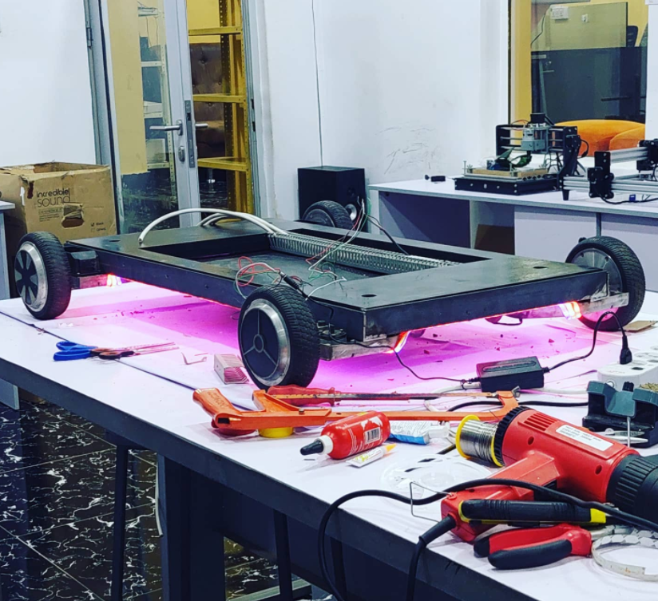
RAIN IMoRP at the early stage

Slide 18

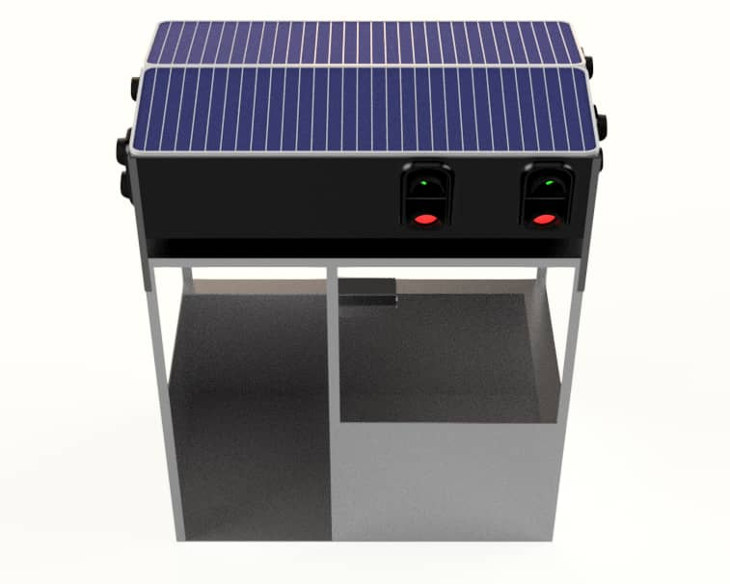


Slide 19
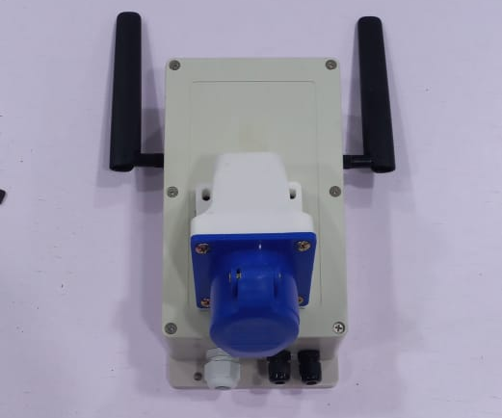
The RAIN SC-75/76 Device

Slide 20
RAIN: Other Potentials
City Wide Central Surveillance System
Robust Unmanned Ground Vehicle for Extreme Environment Exploration
Training to Solve the Existing Skill Gap

Slide 21






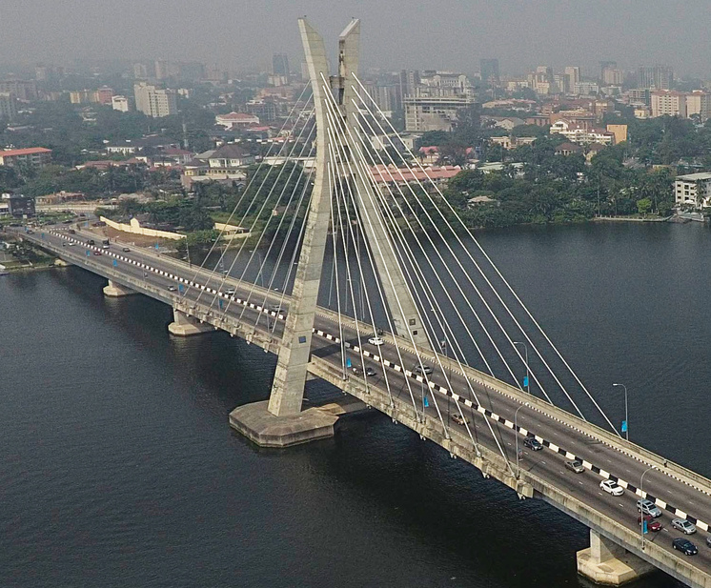
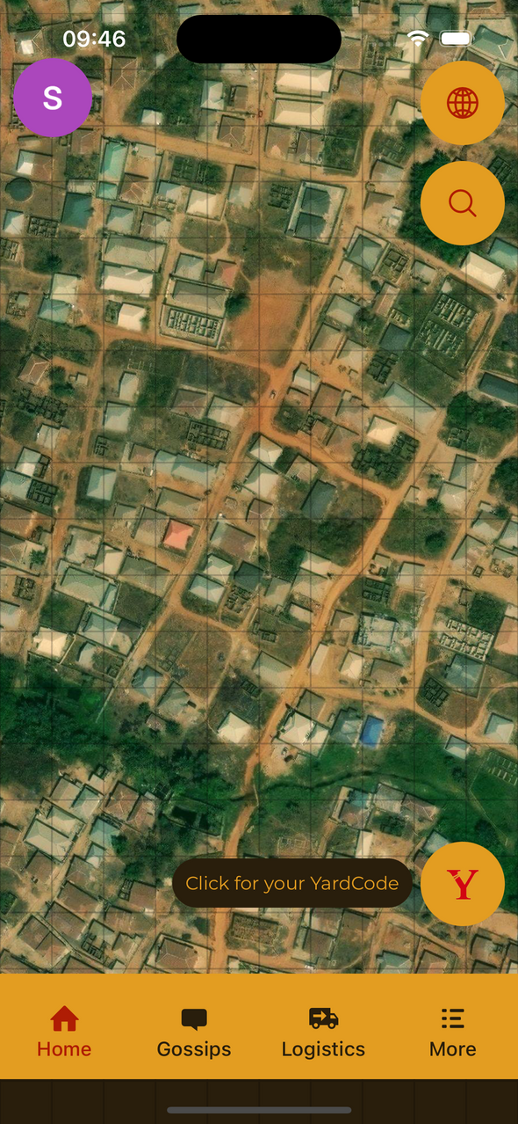




YARDCODE
DIGITAL ADDRESSING FOR NIGERIA
www.yardcode.ng

Slide 22



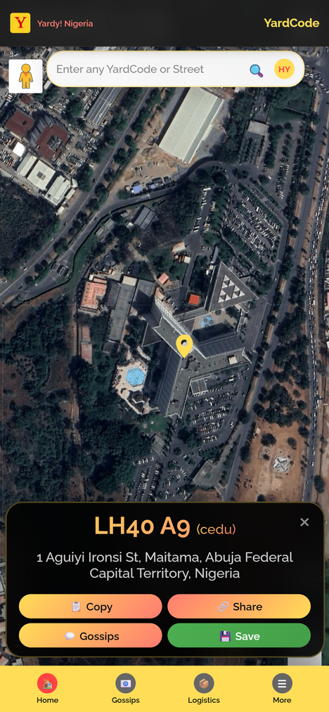
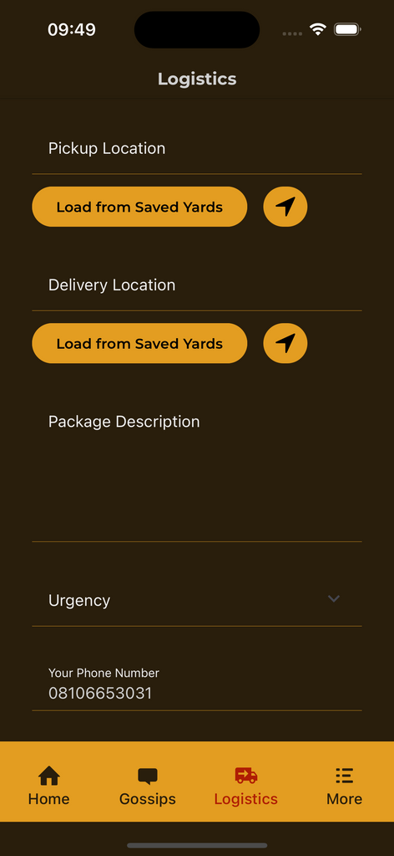


INTRODUCING
YARDCODE
FREE TO USE
RELIABLE
No hidden charges. Every Nigerian gets their YardCode at zero cost - forever
From Lagos Island to remote villages - if you're in Nigeria, you can get yourYardCode
WORKS ANYWHERE
PERFECT FOR YOU
Works 24/7, rain or shine. When other systems fail, YardCode delivers
Simple enough for grandma, smart enough for tech experts. Built for every Nigerian

Slide 23
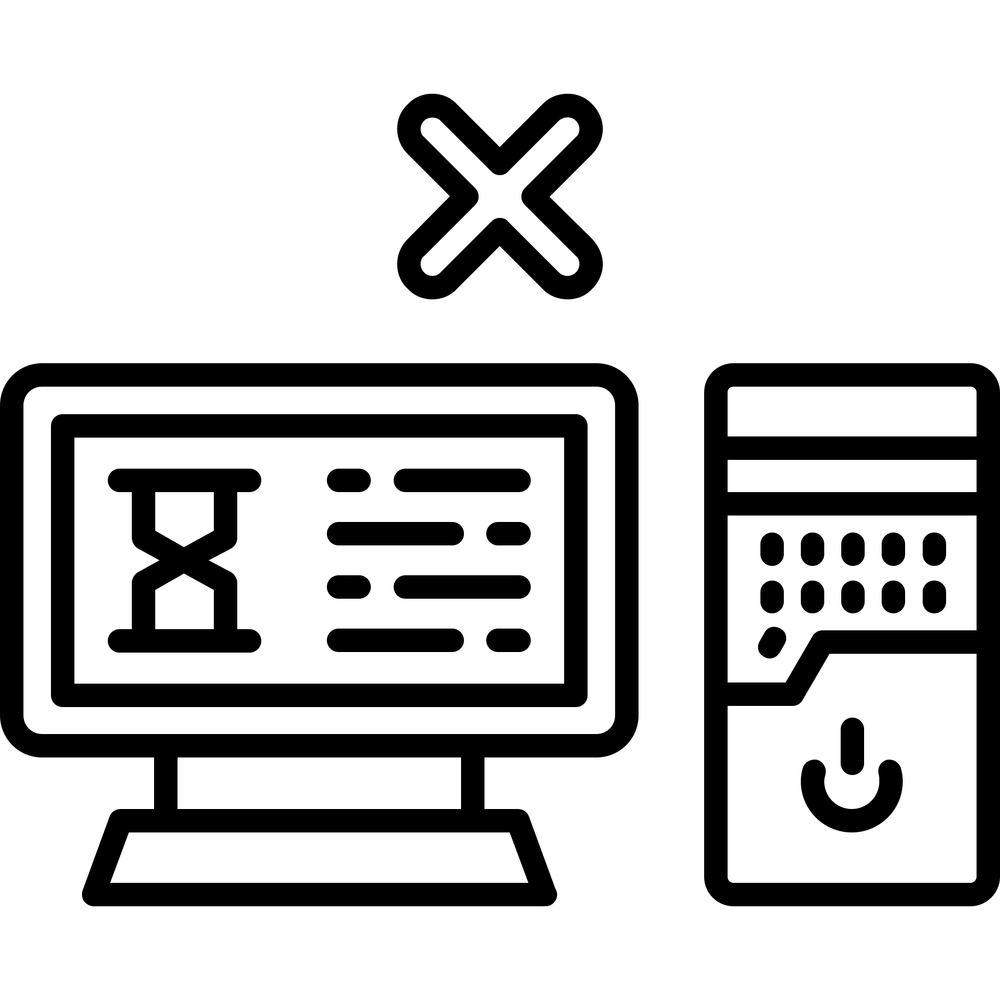









THE PROBLEM WE'RE SOLVING
CURRENT CHALLENGES:
COST:
Current postcode system is obsolete
and fails to meet digital needs
Delayed emergency responses
Inconsistent Address Standards
No unified system for house numbering and street naming
Failed package deliveries
Infrastructure Gaps
Poor census and demographic data
Remote areas lack proper addressing, hindering service delivery
Economic Impact
Poor addressing limits financial inclusion, logistics, and emergency services
Lack of Brand Differentiation
GPS Complexity
Reduced investment in remote areas
Traditional GPS coordinates are too long and difficult to remember

Slide 24
UNIQUE IDENTIFIER
MATHEMATICAL FOUNDATION
What Sets YardCode Apart
Every 1m x 1m grid gets a unique, memorable code (e.g., GQ9 U88)
No database dependency - purely mathematical relationships
RELATED POSITIONING
PERMANENT SYSTEM
Adjacent locations have related codes (unlike What3Words)
Sustainable, energy-efficient, requiring minimal computational power
SMALLER GRID
NO DATABASE DEPENDENCY
Key Differentiators
1m x 1m precision vs. competitors' 3m x 3m
Mathematical algorithm reduces infrastructure needs
LOGICAL SEQUENCE
NIGERIAN-BUILT
Related codes for adjacent areas
Designed specifically for Nigerian addressing standards

Slide 25

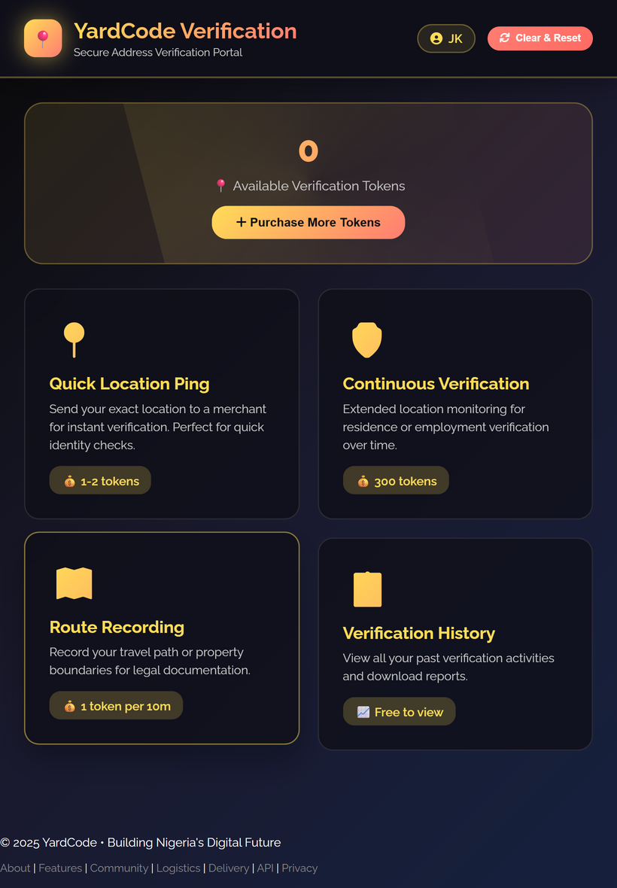



COMPREHENSIVE PLATFORM SERVICES
Beyond Just Codes - A Complete Ecosystem*
WEB SERVICE
MOBILE APP
DEVELOPER API
Free YardCode lookup for all Nigerians
Street address to YardCode conversion
Google Street View integration for accuracy
View and share local yard gossips
Offline functionality- works without internet
Available on Google Play Store and Apple App Store
Real-time location services
Convert YardCodes to GPS coordinates
Integration with existing platforms
Scalable for enterprise solutions

Slide 26

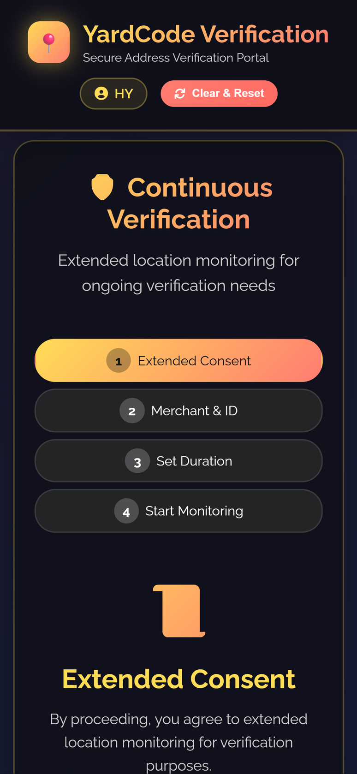
ADDRESS VERIFICATION PORTAL
01
AI-powered residency verification for over 7-30 days
02
28 daily location pings for accuracy
03
20-meter tolerance for same premise verification
04
Digital certificates for confirmed addresses & Annual re-verification reminders

Slide 27
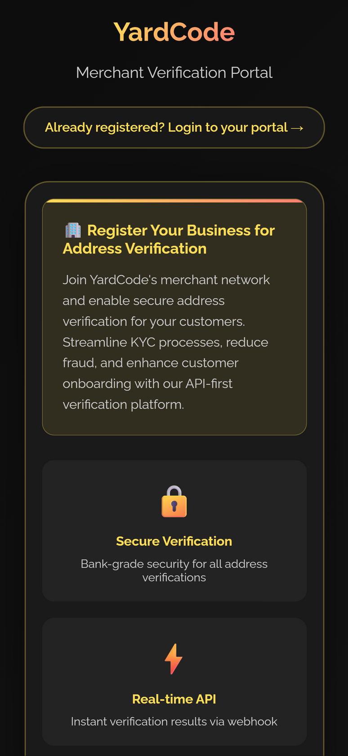
MERCHANT PORTAL
01
Dashboard for managing location requests
02
User permission management
03
Billing/subscription management

Slide 28
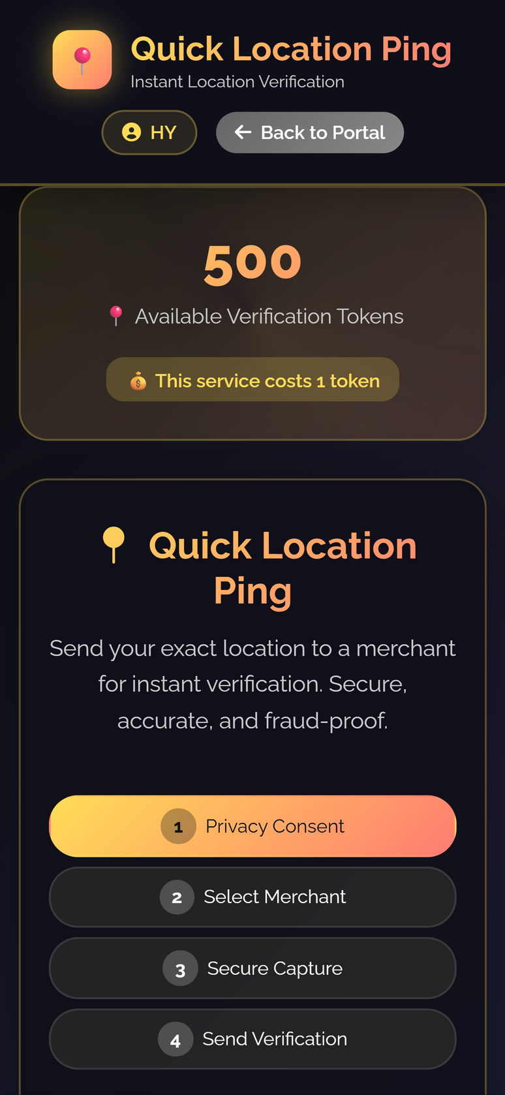
PING ADDRESS FEATURE
01
Uneditable location sharing for security and trust
02
Instant YardCode + photo verification
03
Perfect for field workers, students, security personnel
04
Direct integration via email or websocket

Slide 29
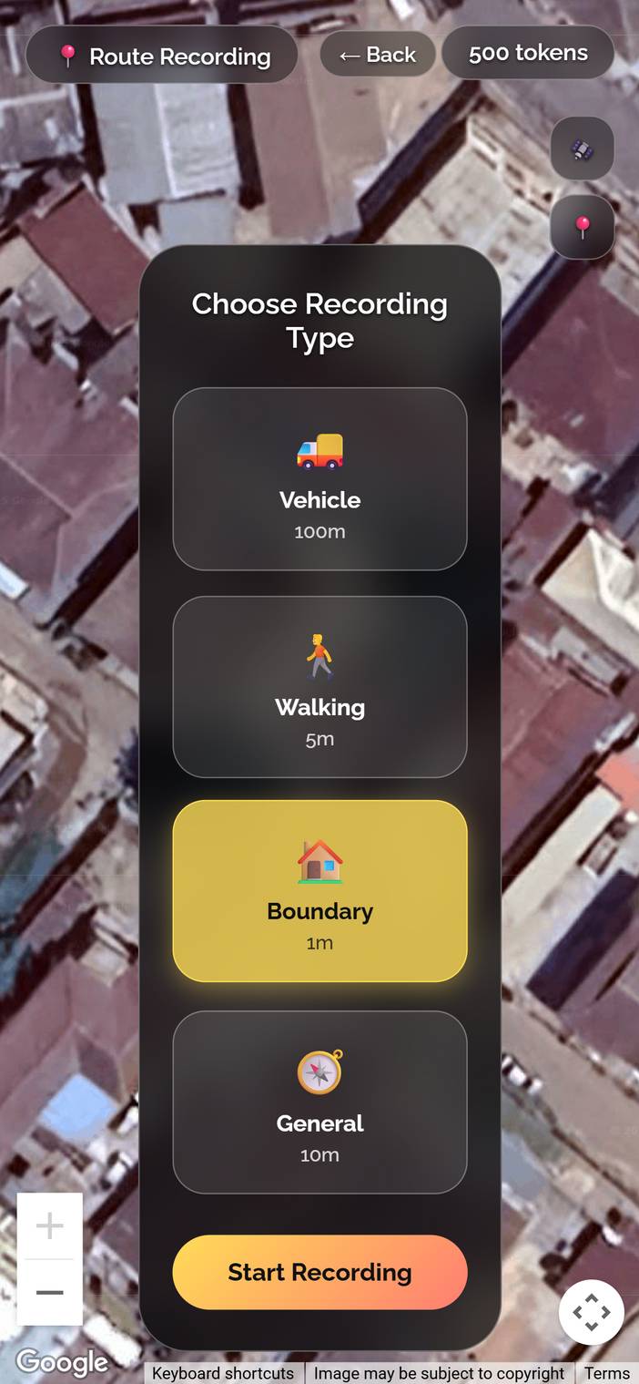
ROUTE RECORDING
01
Start-to-end route tracking
02
Automatic RouteCode generation
03
Organizational integration for logistics

Slide 30



THE FUTURE IS HERE
YARDCODE ISN'T JUST SOLVING A PROBLEM – WE'RE BUILDING THE FOUNDATION FOR NIGERIA'S DIGITAL FUTURE
EVERY ADDRESS MATTERS. EVERY LOCATION COUNTS.
WELCOME TO THE YARDCODE ERA

Slide 31
RAIN · ROBOTICS AND ARTIFICIAL INTELLIGENCE NIGERIA
NRS is actually the Engine Room for National Prosperity
Reimagining the Nigeria Revenue Service as Nigeria's growth partner
Prepared for the visit of the Executive Chairman, Nigeria Revenue Service

Slide 32
THE IMPORTANCE OF AI
Copyright Violation Detection: Use AI tools to monitor digital platforms for pirated content automatically.
Document Review and Automation: NLP tools to quickly analyse contracts, case laws, and submissions.
Chatbots for Public Inquiries: Provide 24/7 assistance to stakeholders about copyright laws and processes.
Automatic copyright registration: AI checks for existing duplicates in the NCC database.
Administrative Efficiency: Data analysis for strategic decision-making

Slide 33
WHAT MORE?
Three Platforms Where
Growth Meets Government

Slide 34
PLATFORM ONE
The Nigerian Trade Exchange
An Alibaba-style marketplace for Nigerian goods and services to reach Africa and the world.
Nigerian manufacturers, artisans, farmers, and service providers sell across Africa and globally
Integrated payment rails and settlement, in partnership with the Central Bank of Nigeria
Tax calculated and collected automatically at point of sale — compliance without confrontation
Logistics and delivery coordinated through the platform, order to doorstep
Every transaction feeds real trade and revenue data back to the Service

Slide 35
PLATFORM TWO
The National Employment & Services Registry
A portal where Nigeria's workers — formal and informal — are seen, connected, and folded into the tax net.
Freelancers, consultants, and contractors register and are discoverable by clients nationwide
Employers and job-seekers meet on one portal — tax registration becomes a byproduct of finding work
PAYE and related remittances automated at the point of payment
A living record of who is working, where, and how — the raw material for real employment statistics

Slide 36
PLATFORM THREE
The Business Growth Desk
A shift in posture — from an office businesses fear, to a desk businesses visit to grow.
Tax advisory tailored to a business's actual stage: startup, SME, or scale-up
A real-time compliance dashboard — business owners always know exactly what they owe
Pathways connecting compliant businesses to credit, grants, and partnership opportunities
Tax education delivered in the language and channel Nigerians already use

Slide 37
THE INTELLIGENCE LAYER
What AI Adds to the Picture

Slide 38
THE INTELLIGENCE LAYER
Six Ways AI Strengthens the Service
Compliance & Risk Profiling
Tax Education at Scale
Automated Auditing
Flag unusual filing patterns and prioritise audit attention where it's genuinely needed.
Voice notes, chatbots, and local-language content that meet Nigerians where they are.
Pre-audit analysis narrows what a human auditor reviews — humans stay in the loop.
Fraud & Impersonation Detection
Field Officer Monitoring
Public-Private Delivery
Continuous monitoring for cloned payment portals impersonating the Service.
YardCode SDK integration tracks officer location, duration, and outcomes in the field.
RAIN and partners build and operate; government sets policy and shares the benefit.

Slide 39
BEYOND REVENUE
What RAIN Already Brings to the Table
01
Building the People
AIML and RDA programmes training the talent capable of building and operating platforms like these, at home.
02
Building the Tools
RIDE, a browser-native robotics simulation platform, and YardCode, Nigeria's own geo-addressing infrastructure — real, deployed systems.
03
Shaping the Policy
Co-authorship of Nigeria's National AI Strategy and a seat on the UNDP AI4Dev Reference Group.
04
Building Across Sectors
Work spanning education, security, and public administration — including AI curricula for Meta's AI Academy Nigeria.

Slide 40
SUMMARY
The Proposal in One Table
Dimension | Today | The RAIN Vision
Primary posture | Collector of what is owed | Partner in what can be earned
Relationship with business | Compliance and enforcement | Growth, trade, and market access
Data on citizens | Filed returns | Live employment, trade, and income data
Technology role | Digitised forms and portals | AI-driven compliance, education, fraud prevention, field intelligence
Where revenue comes from | Enforcement pressure | A growing economy, willingly compliant

